Slide 1
RTOS

Slide 2
Definition
A Real-Time Operating System (RTOS) comprises of two components, viz., “Real-Time” and “Operating System”.
An Operating system (OS) is nothing but a collection of system calls or functions which provides an interface between hardware and application programs. It manages the hardware resources of a computer and hosting applications that run on the computer. An OS typically provides multitasking, synchronization, Interrupt and Event Handling, Input/ Output, Inter-task /process Communication, Timers and Clocks and Memory Management. Core of the OS is the Kernel which is typically a small, highly optimised set of libraries.

Slide 3
OS – Modes
OS runs in two modes
User mode : permitted to run and use only a subset of function and instructions of the OS
Sending a message to a waiting process
Initiating a sys call.
Supervisory mode : runs privileged function and instructions in protected mode , accesses HW resources and protected memory area. Kernel code runs.

Slide 4
Definition
Real-time systems are those systems in which the correctness of the system depends not only on the logical result of computation, but also on the time at which the results are produced.
RTOS is therefore an operating system that supports real-time applications by providing logically correct result within the deadline required. Basic Structure is similar to regular OS but, in addition, it provides mechanisms to allow real time scheduling of tasks.
Real-time operating systems may or may not increase the speed of execution. Provide much more precise and predictable timing characteristics than general-purpose OS.

Slide 5
Definition
RTOS is key to many embedded systems and provides a platform to build applications.
All embedded systems are not designed with RTOS.
Embedded systems with relatively simple/small hardware/code might not require an RTOS.
Embedded systems with moderate-to-large software applications require some form of scheduling, and hence RTOS.

Slide 6
Difference: RTOS V/S General Purpose OS
Determinism
“Deterministic ” timing behavior in the real-time operating systems.
“Deterministic” timing means that OS consume only known and expected amounts of time.
RTOS have their worst case latency defined.
Latency is not of a concern for General Purpose OS.
Task Scheduling :
General purpose operating systems are optimized to run a variety of applications and processes simultaneously, thereby ensuring that all tasks receive at least some processing time. low-priority tasks may have their priority boosted above other higher priority tasks, which the designer may not want.
RTOS uses priority-based preemptive scheduling, which allows high-priority threads to meet their deadlines consistently.

Slide 7
Difference: RTOS V/S General Purpose OS
Preemptive kernel – In RTOS, all kernel operations are preemptible
Priority Inversion – RTOS have mechanisms to prevent priority inversion
Usage –
RTOS are typically used for embedded applications,
General Purpose OS are used for Desktop PCs or other generally purpose PCs.

Slide 8
RTOS Classification
RTOS specifies a known maximum time for each of the operations that it performs. Based upon the degree of tolerance in meeting deadlines, RTOS are classified into following categories
Hard real-time: Degree of tolerance for missed deadlines is negligible. A missed deadline can result in catastrophic failure of the system
Firm real-time: Missing a deadly ne might result in an unacceptable quality reduction but may not lead to failure of the complete system
Soft real-time: Deadlines may be missed occasionally, but system doesn’t fail and also, system quality is acceptable

Slide 9
Hard real time considerations
Strict adherence to task deadlines.
Preemption time less than few microsecs
Predictable performance with no deadline miss .
Disabling of all other interrupt of lower priority.
Preemption of higher priority by lower priority.

Slide 10
Hard real time considerations
Task running in kernel
Provision of asynchronous IO
Provision of spin lock
Predictions of interrupt latencies.
Response to all time slots thus guaranteed task deadlines for sporadic/aperiodic tasks.

Slide 11
Soft real time
In which deadlines are mostly met.
Only the precedence and sequence for task op are defined,
Few deadlines misses are accepted.
Preemption time a few milliseconds

Slide 12
RTOS Features
Multithreading and preemptability – The scheduler should be able to preempt any task in the system and allocate the resource to the thread that needs it most even at peak load.
Thread Priority – All tasks are assigned priority level to facilitate pre-emption.The highest priority task that is ready to run will be the task that will be running.
Inter Task Communication & Synchronization –Multiple tasks pass information among each other in a timely fashion and ensuring data integrity

Slide 13
RTOS Features
Priority Inheritance – RTOS should have large number of priority levels & should prevent priority inversion using priority inheritance.
Short Latencies – The latencies are short and predefined.
Task switching latency: The time needed to save the context of a currently executing task and switching to another task.
Interrupt latency: The time elapsed between execution of the last instruction of the interrupted task and the first instruction in the interrupt handler.
Interrupt dispatch latency: The time from the last instruction in the interrupt handler to the next task scheduled to run.

Slide 14
Posix Compliance
IEEE Portable Operating System Interface for Unix Computer Environments, POSIX 1003.1b (formerly 1003.4) provides the standard compliance criteria for RTOS services. It is designed to allow application programmers to write applications that can easily be ported across OSs.

Slide 15
RTOS services covered by POSIX 1003
The basic RTOS services covered by POSIX 1003.1b include:
Asynchronous I/O: Ability to overlap application processing and I/O operations
Synchronous I/O: Ability to assure return of the interface procedure when the I/O operation is completed.
Memory locking: Ability to guarantee memory residence by storing sections of a process that were not recently referenced on secondary memory devices.

Slide 16
RTOS services covered by POSIX 1003
Semaphores: Ability to synchronize resource access by multiple processes.
Shared memory: Ability to map common physical space into independent process specific virtual space.
Execution scheduling: Ability to schedule multiple tasks. Common scheduling methods include round robin and priority-based preemptive scheduling.
Timers: Timers improve the functionality and determinism of the system. A system should have at least one clock device (system clock) to provide good real-time services.

Slide 17
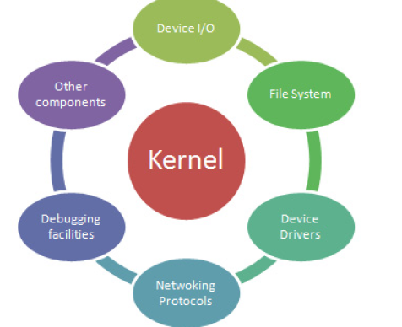
General Architecture of RTOS
For simpler applications, RTOS is usually a kernel but as complexity increases, various modules like networking protocol stacks debugging facilities, device I/Os
are includes in addition to the kernel

Slide 18
Kernel
Is a computer program . Loaded first in the kernel space.
The basic structural unit of any OS in which memory space of the function, data and stack are protected from access by any call other than service call. Secured unit that operates in supervisory mode.
OS is the middle layer between app SW and sys HW. Some or following structural units :
Kernel with file and device mgt

Slide 19
Kernel
Kernel without
Kernel has management function for processes, resources, ISR, IST files device drivers and I/O sys and NW sys.
Memory device and file mgt function may be outside the kernel in a given OS especially in embedded systems.

Slide 20
Kernel services in OS
Process management
Creation and deletion
Process strut maintenance
Processing resource requests
Scheduling
IPC

Slide 21
Kernel services in OS
Memory management allocation and de allocation
File management
Device management
Device drivers
I/O management
ISRs

Slide 22
Kernel Types
RTOS kernel acts as an abstraction layer between the hardware and the applications. There are three broad categories of kernels
Monolithic kernel : Monolithic kernels are part of Unix-like operating systems like Linux, FreeBSD etc. A monolithic kernel is one single program that contains all of the code necessary to perform every kernel related task. It runs all basic system services (i.e. process and memory management, interrupt handling and I/O communication, file system, etc) and provides powerful abstractions of the underlying hardware. Amount of context switches and messaging involved are greatly reduced which makes it run faster than microkernel.

Slide 23
Kernel
Microkernel : It runs only basic process communication (messaging) and I/O control. It normally provides only the minimal services such as managing memory protection, Inter process communication and the process management. The other functions such as running the hardware processes are not handled directly by microkernels. Thus, micro kernels provide a smaller set of simple hardware abstractions. It is more stable than monolithic as the kernel is unaffected even if the servers failed (i.e.File System).
Microkernels are part of the operating systems like AIX, BeOS, Mach, Mac OS X, MINIX, and QNX. Etc

Slide 24
Kernel
Hybrid Kernel : Hybrid kernels are extensions of microkernels with some properties of monolithic kernels. Hybrid kernels are similar to microkernels, except that they include additional code in kernel space so that such code can run more swiftly than it would were it in user space. These are part of the operating systems such as Microsoft Windows NT, 2000 and XP. DragonFly BSD, etc

Slide 25
Kernel
Exokernel : Exokernels provides efficient control over hardware. It runs only services protecting the resources (i.e. tracking the ownership, guarding the usage, revoking access to resources, etc) by providing low-level interface for library operating systems and leaving the management to the application.

Slide 26
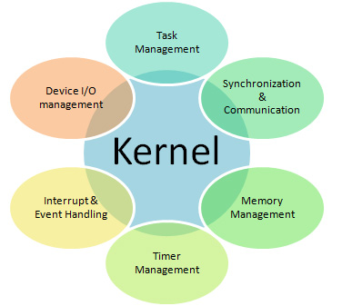
Common Services Offered By a RTOS System

Slide 27
Process
A process (also sometimes referred to as a task) is an executing (i.e., running) instance of a program. In Linux, threads are lightweight processes that can run in parallel and share an address space (i.e., a range of memory locations) and other resources with their parent processes (i.e., the processes that created them).

Slide 28
Process
App program – consists of no of processes and each process under control of OS.
Consists of sequentially exec program codes and state- control by OS.
A state during running of a process is represented by info of process state (created, blocked or fin), process strut – its data, objects and resource, and PCB
Runs on scheduling by OS (kernel)which gives the control of the CPU to the process.
Runs instructions and the continuous change of its state takes place as the PC changes.

Slide 29
Process creation
At reset
OS initialised.
Initial process created.
OS started and initial process run.

Slide 30
Process creation
Processes created hierarchically
Initial process creates subsequent processes
OS schedules the processes and provides for context switching between processes and threads.
Creation of a process means specifying the resources for the process and address space for the created process, stack, data and heap and placing the process initial info at the PCB or TCB.
PCB is a process descriptor used by the process manager.

Slide 31
Context
A context is the contents of a CPU's registers and program counter at any point in time.
A register is a small amount of very fast memory inside of a CPU (as opposed to the slower RAM main memory outside of the CPU) that is used to speed the execution of computer programs by providing quick access to commonly used values, generally those in the midst of a calculation.
A program counter is a specialized register that indicates the position of the CPU in its instruction sequence and which holds either the address of the instruction being executed or the address of the next instruction to be executed, depending on the specific system.

Slide 32
Context switch:
A context switch is the computing process of saving and restoring the state (context) of a CPU such that multiple processes can share a single CPU resource.
The context switch is an essential feature of a multitasking operating system.
Context switches are usually time consuming and much of the design of operating systems is to minimize the time of context switches.
A context switch can mean a register context switch, a task context switch, a thread context switch, or a process context switch. What will be switched is determined by the processor and the operating system.
The scheduler is the part of the operating systems that manage context switching, it perform context switching in one of the following conditions

Slide 33
Context switch
1. Multitasking: One process needs to be switched out of (termed "yield" which means "give up") the CPU so another process can run. Within a preemptive multitasking operating system, the scheduler allows every task (according to its priority level) to run for some certain amount of time, called its time slice where a timer interrupt triggers the operating system to schedule another process for execution instead. If a process will wait for one of the computer resources or will perform an I/O operation, the operating system schedules another process for execution instead.
2. Interrupt handling: Some CPU architectures are interrupt driven. When an interrupt occurs, the scheduler calls its interrupt handler in order to serve the interrupt after switching contexts; the scheduler suspended the currently running process till executing the interrupt handler.

Slide 34
Context switch
3. User and kernel mode switching: When a transition between user mode and kernel mode is required in an operating system, a context switch is not necessary; a mode transition is not by itself a context switch. However, depending on the operating system, a context switch may also take place at this time. Context switching can be performed primarily by software or hardware. Some CPUs have hardware support for context switches, else if not, it is performed totally by the operating system software. In a context switch, the state of a process must be saved somehow before running another process, so that, the scheduler resume the execution of the process from the point it was suspended; after restoring its complete state before running it again.

Slide 35
Context switch
Context switching can be described in slightly more detail as the kernel (i.e., the core of the operating system) performing the following activities with regard to processes (including threads) on the CPU:
suspending the progression of one process and storing the CPU's state (i.e., the context) for that process somewhere in memory,
retrieving the context of the next process from memory and restoring it in the CPU's registers and
returning to the location indicated by the program counter (i.e., returning to the line of code at which the process was interrupted) in order to resume the process

Slide 36
Management of Created Process
A process (thread, task) is a unit in which sequential running is feasible under control of OS with each process having a PCB/TCB.
Process management enables creation, activation, running, blocking, resumption, deactivation and deletion.
Done by process manager.
Creates the process, allocates to each a PCB, manages access to resources and facilitates switching from one process to another.

Slide 37
PCB
Is a data strut having the info using which the OS control the process state. Stores in protected memory add at kernel.
Following info :
Process ID
Allocate program memory add in physical memory and in sec memory for the process code
Allocate process SP data add blocks.
Allocate process heaps

Slide 38
PCB/TCB
Describes the following:
Context : PSW, PC, SP and other CPU register at the instant of the last instruction run exec when the process was left and switched to another process .
Process stack pointer
Current state : created, activated or spawned
Addresses that are allotted
Pointer for parent process

Slide 39
PCB/TCB
Pointer to a list of resources that can be used
Pointer to a list of process that usable more than once
Pointer to queue of msgs
Pointer to access permissions descriptor for sharing set of resources globally.
ID by which iden is made by process mgr.

Slide 40
PCB
Allocate process stack address for the function called during running of the process.
Allocate address of CPU register save memory
Process state signal mask
Signals (and messages) dispatch tables (for process IPC function)
OS allocate resource descriptors
Security restrictions and permissions

Slide 41
Location of the PCB
Since the PCB contains the critical information for the process, it must be kept in an area of memory protected from normal user access. In some operating systems the PCB is placed in the beginning of the kernel stack of the process since that is a convenient protected location

Slide 42
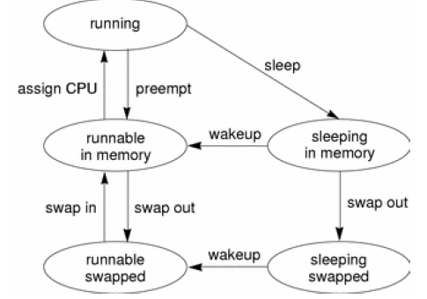
Process State Transition

Slide 43
Process State Transition
An active process is normally in one of the five states in the diagram. The arrows show how the process changes states.
A process is running if the process is assigned to a CPU. A process is removed from the running state by the scheduler if a process with a higher priority becomes runnable. A process is also pre-empted if a process of equal priority is runnable when the original process consumes its entire time slice.
A process is runnable in memory if the process is in primary memory and ready to run, but is not assigned to a CPU.

Slide 44
Process State Transition
A process is sleeping in memory if the process is in primary memory but is waiting for a specific event before continuing execution. For example, a process sleeps while waiting for an I/O operation to complete, for a locked resource to be unlocked, or for a timer to expire. When the event occurs, a wakeup call is sent to the process. If the reason for its sleep is gone, the process becomes runnable.
When a process' address space has been written to secondary memory, and that process is not waiting for a specific event, the process is runnable and swapped.
If a process is waiting for a specific event and has had its whole address space written to secondary memory, the process is sleeping and swapped.

Slide 45
Process State Transition
If a machine does not have enough primary memory to hold all its active processes, that machine must page or swap some address space to secondary memory.
When the system is short of primary memory, the system writes individual pages of some processes to secondary memory but leaves those processes runnable. When a running process, accesses those pages, the process sleeps while the pages are read back into primary memory.
When the system encounters a more serious shortage of primary memory, the system writes all the pages of some processes to secondary memory. The system marks the pages that have been written to secondary memory as swapped. Such processes can only be scheduled when the system scheduler daemon selects these processes to be read back into memory.

Slide 46
Thread
Is a process or sub process within a process. Has its own PC and SP, own priority parameter for its scheduling by thread schedule.
Its variable loads itself into processor register on context switching
Has own signal mask at kernel.
When Unmasked- activate and run

Slide 47
Thread
When Masked put in queue of pending threads.
Thread stack allocated by OS
When function in thread in OS is called, calling function state placed on top of stack
When returning calling function takes state info from stack

Slide 48
Task
Is defined as an embedded program computational unit that runs on a CPU under cont of OS. It has a state, which at an instance is defined by status(running, blocked, fin) structure - its data ,objects and resources and control block.

Slide 49
Task Management
In RTOS, The application is decomposed into small, schedulable, and sequential program units known as “Task”, a basic unit of execution and is governed by three time-critical properties; release time, deadline and execution time.
Release time refers to the point in time from which the task can be executed.
Deadline is the point in time by which the task must complete.
Execution time denotes the time the task takes to execute.

Slide 50
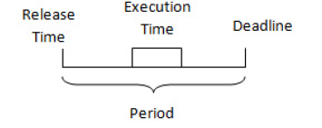
Task Management - Timing

Slide 51
Task States
Each task may exist in following states
Dormant : Task doesn’t require computer time
Ready: Task is ready to go active state, waiting processor time
Active: Task is running
Suspended: Task put on hold temporarily
Pending: Task waiting for resource.

Slide 52
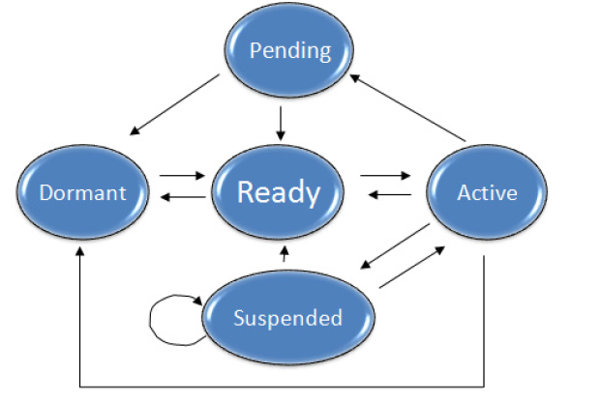
Task States

Slide 53
Task States
During the execution of an application program, individual tasks are continuously changing from one state to another. However, only one task is in the running mode (i.e. given CPU control) at any point of the execution.
In the process where CPU control is changed from one task to another, context of the to-be-suspended task will be saved while context of the to-be-executed task will be retrieved, the process referred to as context switching.

Slide 54
Task Object
A task object is defined by the following set of components:
Task Control block: Task uses TCBs to remember its context. TCBs are data structures residing in RAM, accessible only by RTOS
Task_ID
Task_State
Task_Priority
Task_Stack_Pointer
Task_Prog _Counter
Task Stack: These reside in RAM, accessible by stack pointer.
Task Routine: Program code residing in ROM

Slide 55
TCB
Task Control Block - The Task Control Block (TCB) specifies all the parameters necessary to schedule and execute a routine. Typically, a TCB is a 6-10 words long and is logically divided into two parts:
Task-Independent Parameters - The first four words (32-bit) of the TCB are task-independent and simply specify the scheduling parameters to the DSP scheduler.
Task-Dependent Parameters - These parameters specify the routine to be executed and the parameters of execution. The number and format of these parameters is routine dependent.

Slide 56
Task and Data
Task has following data which it stores on TCB.
ID. One byte called index. No between 0-255.
May have priority parameter. Rep by a byte.
Independent values of the following:
Memory address in CPU
SP and PC

Slide 57
Task and Data
Context : CPU registers and parameters which including registers for task PC and pointer to the called function stack top. Reflects CPU state just before OS blocks one task. Continuously updates when running and saved before switching occurs.
Context switch : after saving CPU control switch. Must retrieve on transfer of program control back for running the same task.

Slide 58
Scheduler
The scheduler keeps record of the state of each task and selects from among them that are ready to execute and allocates the CPU to one of them.
Various scheduling algorithms are used in RTOS

Slide 59
Basic Concepts of Scheduling
Task Instance.
Event occurs, task generated to handle event
Recur a number of times depending on different instances of time.
Events : Periodic or Random
Time task occurs is called instance of that task. J^{th} instance of task T_{i} is T_{i(j)}.
Each instance is associated with a deadline.
Task instances also referred to as process.

Slide 60
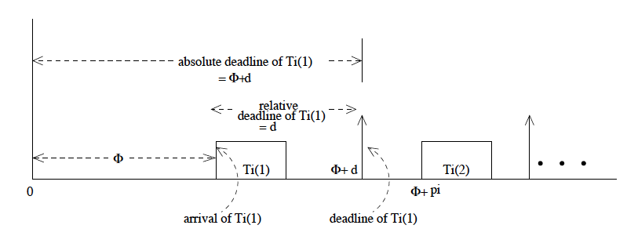
Basic Concepts of Scheduling
Relative deadline Vs Absolute Deadline :
Absolute deadline = time between time zero and actual instant at which deadline occurs.
Relative deadline = time interval between arrival of task and corresponding deadline.

Slide 61
Basic Concepts of Scheduling
Response time : Time it takes for a task to produce a result from its occurrence. Measure of performance = minimum average response time.
Task Precedence : A task is said to precede over another task if is to complete execution before the second task.
Data Sharing with or without precedence.

Slide 62
Types of real Time Tasks
Based on period of time :
Periodic :
Task repeating after certain fixed interval.
Demarcated by clock interrupts.
Known as clock driven tasks
Fixed time interval = PERIOD OF TASK = p_{i}
ϕ_{i} = phase of task, d_{i} = relative deadline, e_{i} = execution time.
4 tuple T_{i} = (ϕ_{i,} p_{i,} e_{i ,}d_{i} )

Slide 63
Types of real Time Tasks
Based on period of time :
Sporadic :
Task recurring at random interval.
g_{i} = minimum separation between two consecutive sporadic tasks.
d_{i} = relative deadline, e_{i} = execution time.
3 tuple T_{i} = ( e_{i ,} g_{i,} d_{i} )
Used for highly critical to moderately critical tasks

Slide 64
Types of real Time Tasks
Based on period of time :
Aperiodic :
Similar to sporadic tasks.
Only difference is g_{i} = 0 ie. Two consecutive aperiodic tasks can occur at the same time.
Deadline is also the average value.
Mostly for soft real time systems as they occur in quick succession and may not meet deadline.

Slide 65
Task Scheduling Basic Concepts
Basic Concepts and Terminologies.
Feasible schedule :
Is a valid schedule in which all the tasks meet their timing constraints.
Proficient Scheduler : Scheduler one is more proficient than scheduler two if all the tasks of scheduler two is schedulable by scheduler one and not vice versa.
Optimal Scheduler : A real time scheduler if it can schedule any task set that can be scheduled by any other scheduler.

Slide 66
Task Scheduling Basic Concepts
Basic Concepts and Terminologies.
Scheduling Points:
Are points on the time line where the scheduler makes the decision on which task to run next.
Scheduler need not run continuously.
Activated by OS at Scheduling points.
For clock driven scheduler , defined by instances marked by interrupts generated by periodic tasks.
For event driven scheduler, determined by occurance of events.

Slide 67
Task Scheduling Basic Concepts
Basic Concepts and Terminologies.
Preemptive Scheduler : Higher priority task suspends lower priority task. Lower priority task resume only when no higher priority task is waiting.
Utilisation : For periodic task T_{i} , U_{i} = e_{i}/p_{i} .
Set of periodic tasks { T_{i }} , U = Σ ^{n}_{i=1} e_{i}/p_{i .}
Objective of good scheduling – higher utilisation

Slide 68
Task Scheduling Basic Concepts
Basic Concepts and Terminologies.
Jitter:
Deviation from strict periodic behavior.
Arrival time jitter – due to improper clock.
Completion time jitter – due to improper scheduling algorithm.
Not desirable.

Slide 69
Classification of Real Time Scheduling Algorithm
Three Broad Classes :
Clock Driven : Scheduling points decided by interrupts received from clock.
Table Driven
Cyclic
Event Driven : Scheduling points decided by certain events.
Simple priority
Rate Monotonic
Earliest Deadline First.
Hybrid : Both clock interrupts and evevts
Round Robin

Slide 70
Classification of Real Time Scheduling Algorithm
Based on type of task acceptance :
Planning Based : Task arrives. Scheduler decides whether task can meet deadline. If not rejected.
Best Effort : No acceptance tests.
Based on type of target platform
Uniprocessor : simple
Multiprocessor : decision regarding which task to run on which processor
Distributed : Same as multiprocessor. No shared memory and global updation of information. Communication through message passing. Very costly

Slide 71
Scheduling
Co-op sch of ready task in a circular queue
Co-op sch with precedence constraints
Cyclic and round robin
Preemptive
Earliest deadline first
Rate monotonic
Fixed time
Peroidic sporadic and aperoidic tasks
Adv sch using stochastic process.

Slide 72
Process Scheduling
In a multitasking system, a mechanism within an OS, called a scheduler is responsible for determining the order and the duration of tasks to run on the CPU. The scheduler selects which tasks will be in what states (READY, RUNNING, or BLOCKED), as well as loading and saving the TCB information for each task. On some OSs the same scheduler allocates the CPU to a process that is loaded into memory and ready to run, while in other OSs a dispatcher (a separate scheduler) is responsible for the actual allocation of the CPU to the process.

Slide 73
OS Block diagram and the scheduler.

Slide 74
Process Scheduling
There are many scheduling algorithms implemented in embedded OSs, and every design has its strengths and tradeoffs. The key factors that impact the effectiveness and performance of a scheduling algorithm include its
response time (time for scheduler to make the context switch to a ready task and includes waiting time of task in ready queue),
turnaround time (the time it takes for a process to complete running),

Slide 75
Process Scheduling
overhead (the time and data needed to determine which tasks will run next), and
fairness (what are the determining factors as to which processes get to run).
A scheduler needs to balance utilizing the system’s resources, keeping the CPU, I/O, as busy as possible, with task throughput, processing as many tasks as possible in a given amount of time.
In the case of fairness, the scheduler has to ensure that task starvation, where a task never gets to run, doesn’t occur when trying to achieve a maximum task throughput.
Scheduling algorithms implemented in embedded OSs typically fall under two approaches: non-pre-emptive and pre-emptive scheduling.

Slide 76
Non-pre-emptive approach First Come First Served (FCFS) / Run - To-Completion
Tasks in the READY queue are executed in the order they entered the queue and these tasks are run until completion when . Here, non pre-emptive means there is no BLOCKED queue in an FCFS scheduling design. The response time is typically slower than other algorithms (i.e., especially if longer processes are in front of the queue requiring that other processes wait their turn), which then becomes a fairness issue since short processes at the end of the queue get penalized for the longer ones in front. With this design, however, starvation is not possible.

Slide 77
Shortest Process Next (SPN)/Run-To-Completion
where tasks in the READY queue are executed in the order in which the tasks with the shortest execution time are executed first . The SPN algorithm has faster response times for shorter processes. However, then the longer processes are penalized by having to wait until all the shorter processes in the queue have run. In this scenario, starvation can occur to longer processes if the ready queue is continually filled with shorter processes. The overhead is higher than that of FCFS, since the calculation and storing of run times for the processes in the ready queue must occur.

Slide 78
Co-operative
where the tasks themselves run until they tell the OS when they can be context switched (for I/O, etc.). This algorithm can be implemented with the FCFS or SPN algorithms, rather than the run-to-completion scenario, but starvation could still occur with SPN if shorter processes were designed not to “cooperate,”

Slide 79
Pre-emptive scheduling
The OS forces a context-switch on a task, whether or not a running task has completed executing or is cooperating with the context switch. Common scheduling algorithms based upon the pre-emptive approach include: Round Robin/FIFO (First In First Out) scheduling, priority (pre-emptive) scheduling, and EDF (Earliest Deadline First)/Clock Driven scheduling.

Slide 80
Round Robin/FIFO Scheduling
The Round Robin/FIFO algorithm implements a FIFO queue that stores ready processes (processes ready to be executed). Processes are added to the queue at the end of the queue and are retrieved to be run from the start of the queue. In the FIFO system, all processes are treated equally regardless of their workload or interactivity. This is mainly due to the possibility of a single process maintaining control of the processor, never blocking to allow other processes to execute.

Slide 81
Round Robin/FIFO Scheduling
Each process in the FIFO queue is allocated an equal time slice (the duration each process has to run), where an interrupt is generated at the end of each of these intervals to start the pre-emption process. The scheduler then takes turns rotating among the processes in the FIFO queue and executing the processes consecutively, starting at the beginning of the queue. New processes are added to the end of the FIFO queue, and if a process that is currently running isn’t finished executing by the end of its allocated time slice, it is pre-empted and returned to the back of the queue to complete executing the next time its turn comes around. If a process finishes running before the end of its allocated time slice, the process voluntarily releases the processor, and the scheduler then assigns the next process of the FIFO queue to the processor

Slide 82
Round Robin/FIFO Scheduling
While Round Robin/FIFO scheduling ensures the equal treatment of processes, drawbacks surface when various processes have heavier workloads and are constantly pre-empted, thus creating more context switching overhead. Another issue occurs when processes in the queue are interacting with other processes (such as when waiting for the completion of another process for data) and are continuously pre-empted from completing any work until the other process of the queue has finished its run. The throughput depends on the time slice. If the time slice is too small, then there are many context switches, while too large a time slice isn’t much different from a non-pre-emptive approach, like FCFS. Starvation is not possible with the round-robin implementation.

Slide 83
Round Robin/FIFO Scheduling

Slide 84
Priority (Pre-Emptive) Scheduling
Differentiates between processes based upon their relative importance to each other and the system. Every process is assigned a priority, which acts as an indicator of orders of precedence within the system. The processes with the highest priority always pre-empt lower priority processes when they want to run, meaning a running task can be forced to block by the scheduler if a higher priority task becomes ready to run.

Slide 85
Priority (Pre-Emptive) Scheduling
Figure shows three tasks (1, 2, and 3, where task 1 is the lowest priority task and task 3 is the highest), and task 3 pre-empts task 2 and task 2 pre-empts task 1.

Slide 86
Priority (Pre-Emptive) Scheduling
While this scheduling method resolves some of the problems associated with round-robin/ FIFO scheduling in dealing with processes that interact or have varying workloads, new problems can arise in priority scheduling including:
Process starvation: a continuous stream of high priority processes keep lower priority processes from ever running. Typically resolved by aging lower priority processes (as these processes spend more time on queue, increase their priority levels).

Slide 87
Priority (Pre-Emptive) Scheduling
Priority inversion: higher priority processes may be blocked waiting for lower priority processes to execute, and processes with priorities in between have a higher priority in running, thus the lower priority as well as higher priority processes don’t run.

Slide 88
Rate Monotonic Scheduling
Technique that can be used to assign task priorities
Tasks are assigned a priority based upon how often they execute within the system.
Given a pre-emptive scheduler and a set of tasks that are completely independent (no shared data or resources) and are run periodically (meaning run at regular time intervals), the more often a task is executed within this set, the higher its priority should be.

Slide 89
Rate Monotonic Scheduling
The RMS Theorem says that if the above assumptions are met for a scheduler and a set of “n” tasks, all timing deadlines will be met if the inequality
ΣEi/Ti ≤ n(2^{1/n} – 1) is verified,
where i is the Periodic task,
n is the number of Periodic tasks,
Ti is the execution period of task i,
Ei is the worst-case execution time of task i, and
Ei/Ti is the fraction of CPU time required to execute task i.

Slide 90
Rate Monotonic Scheduling
So, given two tasks that have been prioritized according to their periods, where the shortest period task has been assigned the highest priority, the “n(2^{1/n} – 1)” portion of the inequality would equal approximately 0.828, meaning the CPU utilization of these tasks should not exceed about 82.8% in order to meet all hard deadlines.

Slide 91
Rate Monotonic Scheduling
For 100 tasks that have been prioritized according to their periods, where the shorter period tasks have been assigned the higher priorities, CPU utilization of these tasks should not exceed approximately 69.6% (100 * (21/100 – 1)) in order to meet all deadlines.

Slide 92
EDF/Clock Driven Scheduling
schedules priorities to processes according to three parameters: frequency (number of times a process is run), deadline (when processes execution needs to be completed), and duration (time it takes to execute the process). While the EDF algorithm allows for timing constraints to be verified and enforced (basically guaranteed deadlines for all tasks), the difficulty is defining an exact duration for various processes. Usually, an average estimate is the best that can be done for each process.

Slide 93
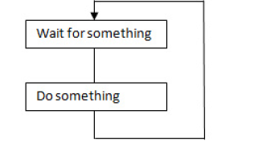
Polled Loop
Sequentially determines if specific task requires time

Slide 94
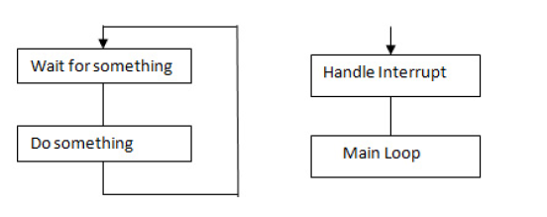
Polled System with interrupts
In addition to polling, it takes care of critical tasks.

Slide 95
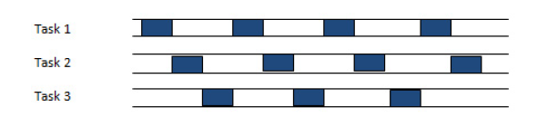
Round Robin
Sequences from task to task, each task getting a slice of time

Slide 96
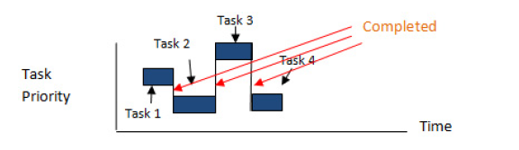
Non pre-emptive scheduling or Cooperative Multitasking:
Highest priority task executes for some time, then relinquishes control, re-enters ready state.

Slide 97
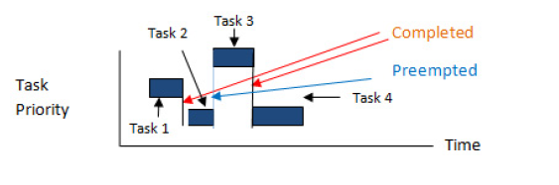
Premptive scheduling Priority multitasking:
Current task is immediately suspended Control is given to the task of the highest priority at all time.

Slide 98
Dispatcher
The dispatcher gives control of the CPU to the task selected by the scheduler by performing context switching and changes the flow of execution

Slide 99
Task Synchronisation
Synchronization is essential for tasks to share mutually exclusive resources (devices, buffers, etc) and/or allow multiple concurrent tasks to be executed (e.g. Task
A needs a result from task B, so task A can only run till task B produces it).

Slide 100
Task Synchronisation
Task synchronization is achieved using two types of mechanisms:
Event Objects
Semaphores.
Event objects are used when task synchronization is required without resource sharing. They allow one or more tasks to keep waiting for a specified event to occur.
Event object can exist either in triggered or non-triggered state. Triggered state indicates resumption of the task.

Slide 101
Event Function
Basically wait function. Takes less time. Some OS do not sp.
OS function as under
Event register. 8,16 or 32 flags which form the group.
Creates using OS func OSEventCreate.
Event reg divided into gps each assigned diff functions.
OSEventQuery ,OSEventDelete
Each event sets bit using SETfunc can also be set by ISR or task. CLEAR
WAIT_ALL and WAIT_ANY.

Slide 102
Semaphores
Allows section of task code wait till another notifies an action. Provides a way of signalling an event occurrence and take note of event (token).
Increments when posted by task ISR instrs and decrements when accepted or taken by waiting task section.
Waiting task section notified to start on sending semaphore. Starts on taking semaphore

Slide 103
Semaphore(sem)
Sem provides mechanism to let a section of the taskcode or a task wait till another task section finishes another set of codes that these section use a common resource, device or file or variable.
When a sem is waiting (for taking or accepting) by task code , then the task has the access to necessary resources when sem is given (sent or posted), the resources unlock
Sem can use the resource key.
Binary sem can be used as mutex as well as notifying flag.

Slide 104
Semaphores.
A semaphore has an associated resource count and a wait queue. The resource count indicates availability of resource. The wait queue manages the tasks waiting for resources from the semaphore. A semaphore functions like a key that define whether a task has the access to the resource. A task gets an access to the resource when it acquires the semaphore.
There are three types of semaphore:
Binary Semaphores
Counting Semaphores
Mutually Exclusion(Mutex) Semaphores

Slide 105
Types of Semophore (sem)
OsS may provide an efficient sync mech called P and V sem in a standard called POSIX 1003.1.b.
Integer values.
P sem functions signals that task requires a resource and if not available waits for it.
V sem functions signals from the task to the OS that the resource is free for other users
Can be used for event signalling, mutex, counting sem and bounded buffer problem soln.

Slide 106
Mutex
When a binary sem is used at the beginning and end of critical sections in two or more tasks such that at any instance only one code can run, then the sem is called mutex. (mutually exclusive)

Slide 107
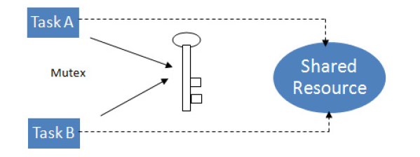
Mutex

Slide 108
IPC
IPC means that a process generates some info by setting or resetting a token or value, or generates and o/p so that it lets another process take note or use it under the control of OS.
OS provide the following IPC functions :
Signals
Sem
As token or mutex
Queues and mailbox
Pipes and sockets
RPC

Slide 109
Inter Process Communication
Inter process communication involves sharing of data among tasks through sharing of memory space, transmission of data, etc. Inter process communications is executed using following mechanisms

Slide 110
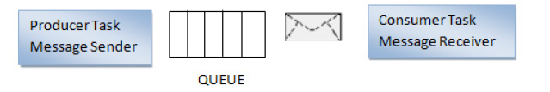
Inter Process Communication
Message queues – A message queue is an object used for intertask communication through which task send or receive messages placed in a shared memory.
The queue may follow 1) First In First Out (FIFO), 2) Last in First Out(LIFO) or 3) Priority (PRI) sequence. Usually, a message queue comprises of an associated queue control block (QCB),
name, unique ID, memory buffers, queue length, maximum message length and one or more task waiting lists.
A message queue with a length of 1 is commonly known as a mailbox

Slide 111
Inter Process Communication
Pipes – A pipe is an object that provide simple communication channel used for unstructured data exchange among tasks. A pipe does not store multiple messages but stream of bytes. Also, data flow from a pipe cannot be prioritized.
Remote procedure call (RPC) – It permits distributed computing where task can invoke the execution of another task on a remote computer.

Slide 112
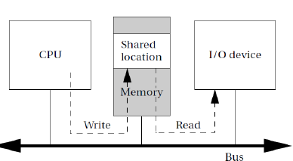
Shared Memory Communication

Slide 113
Shared Memory Communication
Processes often need to communicate with each other. Interprocess communication mechanisms are provided by the operating system as part of the process abstraction.
Figure above illustrates how shared memory communication works in a bus-based system. Two components, such as a CPU and an I/O device, communicate through a shared memory location. The software on the CPU has been designed to know the address of the shared location; the shared location has also been loaded into the proper register of the I/O device. If, as in the figure, the CPU wants to send data to the device, it writes to the shared location. The I/O device then reads the data from that location. The read and write operations are standard and can be encapsulated in a procedural interface.

Slide 114
Message passing
Message passing communication complements the shared memory model. Each communicating entity has its own message send/receive unit. The message is not stored on the communications link, but rather at the senders/ receivers at the end points.
Shared memory communication can be seen as a memory block used as a communication device, in which all the data are stored in the communication link/memory. Applications in which units operate relatively autonomously are natural candidates for message passing communication. For example, a home control system has one microcontroller per household device—lamp, thermostat, faucet, appliance, and so on. The devices must communicate relatively infrequently; furthermore, their physical separation is large enough that we would not naturally think of them as sharing a central pool of memory. Passing communication packets among the devices is a natural way to describe coordination between these devices.
Message passing is the natural implementation of communication in many 8-bit microcontrollers that do not normally operate with external memory

Slide 115
Encapsulation using semaphore and queues
Sem, queries and msgs should not be globally shared variables and each should be shared between a set of tasks only and encapsulated from rest.
Sem : encapsulates the data during critical sections or encap a buffer from reading task or writing into by multiple tasks concurrently.
Queues :can be used to encapsulate the msg to a task at any instance from the multiple tasks.

Slide 116
Memory Management
Two types of memory managements are provided in RTOS – Stack and Heap.
Stack management is used during context switching for TCBs.
Heap management. Memory other than memory used for program code, program data and system stack is called heap memory and it is used for dynamic allocation of data space for tasks. Management of this memory is called heap management

Slide 117
Memory Management
When a process is created the memory manager allocates(blocks) by mapping the process address space. Threads share the memory space of the process.
Memory manager has to be secure robust and well protected . No leaks and stack overflows

Slide 118
Management Strategy
Fixed block allocation
Dynamic blocks allocation
Dynamic page allocation
Dynamic data memory allocation
Dynamic add relocation
Multiprocess memory allocation
Memery protection to OS function

Slide 119
Management Strategy
Memory protection among tasks.
Memory manager manages the foll :
Use of memory add space by process
Specific mechanism to share memory space or restrict sharing of given space
Optimisation of access periods using hierarchy

Slide 120
Timer Function
A real time clk in the system interrupts the system called SysClkIntr.
OS provides number of OS timer functions. These use SysClkIntr.
Periodic SysClkIntr used to switch from supervisory mode to user. Following are the steps
Before service of SysClkIntr the context of presently running task/thread saved on TCB data strut.

Slide 121
Timer Function
SysClkIntr service routine calls the OS.
OS finds new message or IPC
OS either selects the same task or a new task or thread and switches the context to new one.
After return new task runs from code which blocked earlier.

Slide 122
Timer Management
Tasks need to be performed after scheduled durations.
To keep track of the delays, timers- relative and absolute- are provided in RTOS.

Slide 123
Interrupt and event handling
RTOS provides various functions for interrupt and event handling
Defining interrupt handler,
creation and deletion of ISR,
referencing the state of an ISR,
enabling and disabling of an interrupt, etc.
It also restricts interrupts from occurring when modifying a data structure,
minimise interrupt latencies due to disabling of interrupts when RTOS is performing critical operations,
minimises interrupt response times.

Slide 124
Device I/O Management
RTOS generally provides large number of APIs to support diverse hardware device drivers

Slide 125
Device Management
No of device driver ISR of each device.
Each device function calls a separate ISR.
Device manager (inside/outside the kernal) manages.
Coordinates between app process device and device control.
Process send a request to the device function by an interrupt using SWI
Driver provides the action of calling and exec the ISR.
Device manager polls the request at the devices and the actions occur as per priorities.
Device manager manages IO interrupt queues.

Slide 126
Device Mgt
Creates an appropriate kernal interface and API
Device is activated.
OS device manager provides and executes the modules for managing the devices and ISR
Manages physical and virtual devices like pipes and sockets through a common strategy.
Device management has three approaches to three types of device drivers.
Programmed I/O – by polling the service need from each device
Interrupt from device driver ISR
DMA operation used by devices to access memory

Slide 127
Functions of Device Mgr
Device detection
Deletion
Allocation and registration
Detaching and de registration
Restricting device to special process
Sharing
Control

Slide 128
Function of Device Mgr
Access management
Buffer management
Queue management
Driver
Updating of new device function
Backup and restoration

Slide 129
Command Function for Device Management
Create and open
Write
Read
Ioctl
Close and delete.
Ioctl is used for accessing specific partition, defining command and control function of device registers and IO channel control.

Slide 130
I/O subsystems
I/O ports are subsystems of OS device management systems.
Drivers communicate with many devices that use them.
I/O instructions depend on HW platform.

Slide 131
I/O subsystems
Differ in diff OS
Two types of I/O op – sync and async – separate func in RTOS
Sync IO op are at fixed data tfr rates. Therefore a task blocks till completion of IO.
Async IO op are at variable data rates. It provisions for a process of high prioritynot blocked during IO.

Slide 132
I/O subsystem in OS
App
IO basic function
IO device driver function
Device HW or port or IO interface card.

Slide 133
Interrupt routine in RTOS
In a system an ISR should function as follows :
ISR have higher priorities than OS func and app tasks. ISR does not wait for sem, mailbox msg, or queue msg.
Does not wait for mutex else has to wait for other critical sec code to finish before critical codes of ISR can run.

Slide 134
File System Organisation and Implementation
File is a named entity on a magnetic disk, optical disk or system memory.
Contains data, characters and texts or mix.
Each OS may have differing abstractions of files
Named entity as structured record on a disk having random access in the system.
Structured record on a RAM
Unstructured record of bits and bytes.
Pipe like device.

Slide 135
File Sys org and implementation
Necessary to organise files in systematic way and having set of command function.
Due to different approaches to device and file management interfaces develop of a set of standard interfaces become must to make system portable.
POSIX stands for portable op sys interface for coding program when using multiple threads
Same as UNIX sys V interface
Defines the function open, close, read, write , lseek and fcontrol.

Slide 136
Data structure for File Descriptor
Identity
Creator or owner
State – closed, open exec , archived or open for addn.
Locks and protection fields
File information
Sharing permission
Count
Storing media details.

Slide 137
Priority-driven scheduling
we will adopt the following simple rules:
Each process has a fixed priority that does not vary during the course of execution. (More sophisticated scheduling schemes do, in fact, change the priorities of processes to control what happens next.)
The ready process with the highest priority (with 1 as the highest priority of all) is selected for execution.
A process continues execution until it completes or it is preempted by a higher-priority process.

Slide 138
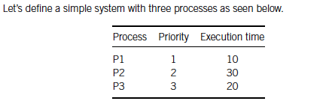
Priority-driven scheduling
In addition to describing the properties of the processes in general, we need to know the environmental setup. We assume that P2 is ready to run when the system is started, P1 is released at time 15, and P3 is released at time 18.

Slide 139
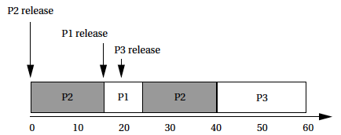
Priority-driven scheduling
Once we know the process properties and the environment, we can use the priorities to determine which process is running throughout the complete execution of the system.

Slide 140
Priority-driven scheduling
When the system begins execution, P2 is the only ready process, so it is selected for execution. At time 15, P1 becomes ready; it preempts P2 and begins execution since it has a higher priority. Since P1 is the highest-priority process in the system, it is guaranteed to execute until it finishes. P3’s data arrive at time 18, but it cannot preempt P1. Even when P1 finishes, P3 is not allowed to run. P2 is still ready and has higher priority than P3. Only after both P1 and P2 finish can P3 execute

Slide 141

Rate-monotonic scheduling
Here is a simple set of processes and their characteristics.

Slide 142
Rate-monotonic scheduling
Applying the principles of RMA, we give P1 the highest priority, P2 the middle priority, and P3 the lowest priority. To understand all the interactions between the periods, we need to construct a time line equal in length to hyperperiod, which is 12 in this case.

Slide 143
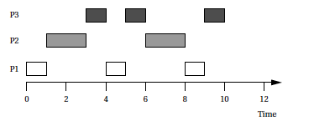
Rate-monotonic scheduling

Slide 144
Rate-monotonic scheduling
All three periods start at time zero. P1’s data arrive first. Since P1 is the highest-priority process, it can start to execute immediately. After one time unit, P1 finishes and goes out of the ready state until the start of its next period. At time 1, P2 starts executing as the highest-priority ready process. At time 3, P2 finishes and P3 starts executing. P1’s next iteration starts at time 4, at which point it interrupts P3. P3 gets one more time unit of execution between the second iterations of P1 and P2, but P3 does not get to finish until after the third iteration of P1.

Slide 145

Rate-monotonic scheduling
Consider the following different set of execution times for these processes, keeping the same deadlines.

Slide 146
Rate-monotonic scheduling
In this case, we can show that there is no feasible assignment of priorities that guarantees scheduling. Even though each process alone has an execution time significantly less than its period, combinations of processes can require more than 100% of the available CPU cycles.
For example, during one 12 time-unit interval, we must execute P1 three times, requiring 6 units of CPU time; P2 twice, costing 6 units of CPU time; and P3 one time, requiring 3 units of CPU time. The total of 6 + 6 + 3 = 15 units of CPU time is more than the 12 time units available, clearly exceeding the available CPU capacity.

Slide 147
Priority inversion
Consider a system with two processes: the higher-priority P1 and the lower-priority P2. Each uses the microprocessor bus to communicate to peripherals. When P2 executes, it requests the bus from the operating system and receives it. If P1 becomes ready while P2 is using the bus, the OS will preempt P2 for P1, leaving P2 with control of the bus. When P1 requests the bus, it will be denied the bus, since P2 already owns it. Unless P1 has a way to take the bus from P2, the two processes may deadlock.

Slide 148
Priority inversion
The most common method for dealing with priority inversion is to promote the priority of any process when it requests a resource from the OS. The priority of the process temporarily becomes higher than that of any other process that may use the resource. This ensures that the process will continue executing once it has the resource so that it can finish its work with the resource, return it to the OS, and allow other processes to use it. Once the process is finished with the resource, its priority is demoted to its normal value.
Several methods have been developed to manage the priority swapping process [

Slide 149
Method of Saving and Optimising Memory space
Compressed data structure.
Make codes compact
Use declaration as unsigned byte
When using data structure limit size of queue. Lists and stack.
Byte arithmetic takes less time than integer
Avoid using library function.
Configure the RTOS function

Slide 150
Method of Saving and Optimising Memory space
Optimise allocation of stack
In case SW design can be made fast with the instruction set, then assembly codes be used.
Use modifier in line rather than calling a function.
Use of static variables.
Combine two functions
Use alternative to switch case statements
When using c++ use class without multiple inheritance
When using java use J2ME

Slide 151
Methods of Saving and Optimising Power
Power saving during exec is imp.
Must provide Wait and Stop instructions and operate in Power down mode. Eg. Brightness of LCD reduced when room lighted.
Continuous running- heavy power dissipation. Auto switch mode to standby.
Disable cache mode. Disconnect strut units not reqd.
Reduce circuit glitches. Stable power
Low voltage operation mode.
Stop state
Wait state
Lower clk speed
LVCMOS in hand held devices
Clever real time program

Slide 152
Typical values of six states of processor
50 mA when processor is running.
75 mA when processor + external memory and chips.
15μA when in stop state
5 and 10 mA in waiting state.

Slide 153
The Advanced Configuration and Power Interface (ACPI)
is an open industry standard for power management services. It is designed to be compatible with a wide variety of OSs. It was targeted initially to PCs. ACPI provides some basic power management facilities and abstracts the hardware layer, the OS has its own power management module that determines the policy, and the OS then uses ACPI to send the required controls to the hardware and to observe the hardware’s state as input to the power manager

Slide 154
The Advanced Configuration and Power Interface (ACPI)
ACPI supports the following five basic global power states:
G3, the mechanical off state, in which the system consumes no power.
G2, the soft off state, which requires a full OS reboot to restore the machine to working condition. This state has four substates:
S1, a low wake-up latency state with no loss of system context;
S2, a low wake-up latency state with a loss of CPU and system cache state;
S3, a low wake-up latency state in which all system state except for main memory is lost;
S4, the lowest-power sleeping state, in which all devices are turned off.

Slide 155
The Advanced Configuration and Power Interface (ACPI)
G1, the sleeping state, in which the system appears to be off and the time required to return to working condition is inversely proportional to power consumption.
G0, the working state, in which the system is fully usable.
The legacy state, in which the system does not comply with ACPI.

Slide 156
The Advanced Configuration and Power Interface (ACPI)
The power manager typically includes an observer, which receives messages through the ACPI interface that describe the system behavior. It also includes a decision module that determines power management actions based on those observations.

Slide 157
Latency and deadlines as performance metrics
Three performance metrics are :
Ratio of the sum of interrupt latencies wrt the sum of exec times.
CPU load
Worst case exec time wrt mean exec time.

Slide 158
CPU load
Each task gives a load to the CPU that equals the task exec time divided by task period
CPU load or sys load for multitasking :
M tasks sum of all tasks and ISR less than 1
When task run only once called aperiodic
When task cannot be scheduled called sporadic.
A preemptive schedule must take into account :
Aperiodic task – preempted only once
Periodic task – preempted after fixed intervals
Sporadic task – check for preemption after min time period of occurence.

Slide 159
Sporadic task model performance metric
T total – total length of sporadic tasks
e - total exec time
T av - mean period between sporadic occurrence
T min - min period between
P – performance metrics
P = P worst = (e* T total/T av)/(e*T total/T min)

Slide 160
Options of RTOS
Own RTOS for small scale
Linux 2.6 or RT Linux
µCOS II
VxWorks
Widows CE
Symbian
QNX
VRTX
palmOS

Slide 161
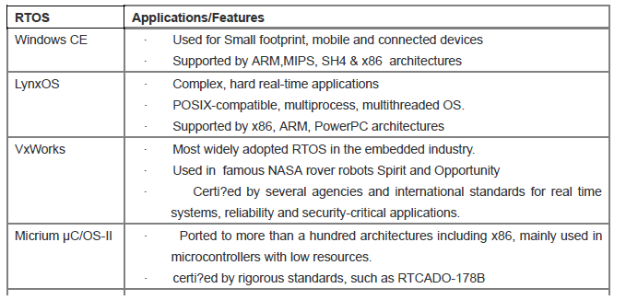
Popular RTOS

Slide 162
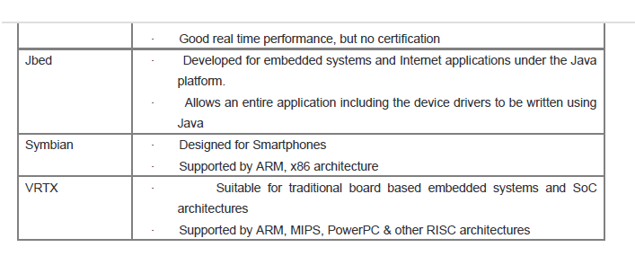
Popular RTOS

